Slide 1
Automating Telescopes to Observe Occultation Events
ASPIRE 2019-2020
Alex Knox

Slide 2
Motivation
Recording occultations from multiple locations allows more data to be collected from an event
More individual observations of an event would increase the number of chords across the object, therefore increasing the accuracy of size and shape constraints
Many features in light curves that indicate rings, satellites, or other things are recorded largely by chance, since the objects in question are so small. More individual observation sites increase the likelihood of detecting one of these points.
Although current technology allows one person to record from multiple locations, the set of these ‘pre-points’ takes time, and can only be done while dark
More complete automation of the current observation process presents the opportunity to remove those time constraints, increasing the number of stations that one person can operate

Slide 3
An Automated Station
The design of an automatic system can be divided into two fundamental components:
Physical characteristics
Automatic capabilities
This project aims to demonstrate that a device could be made to observe an occultation completely autonomously by proving that the mechanics for automation are possible.

Slide 4
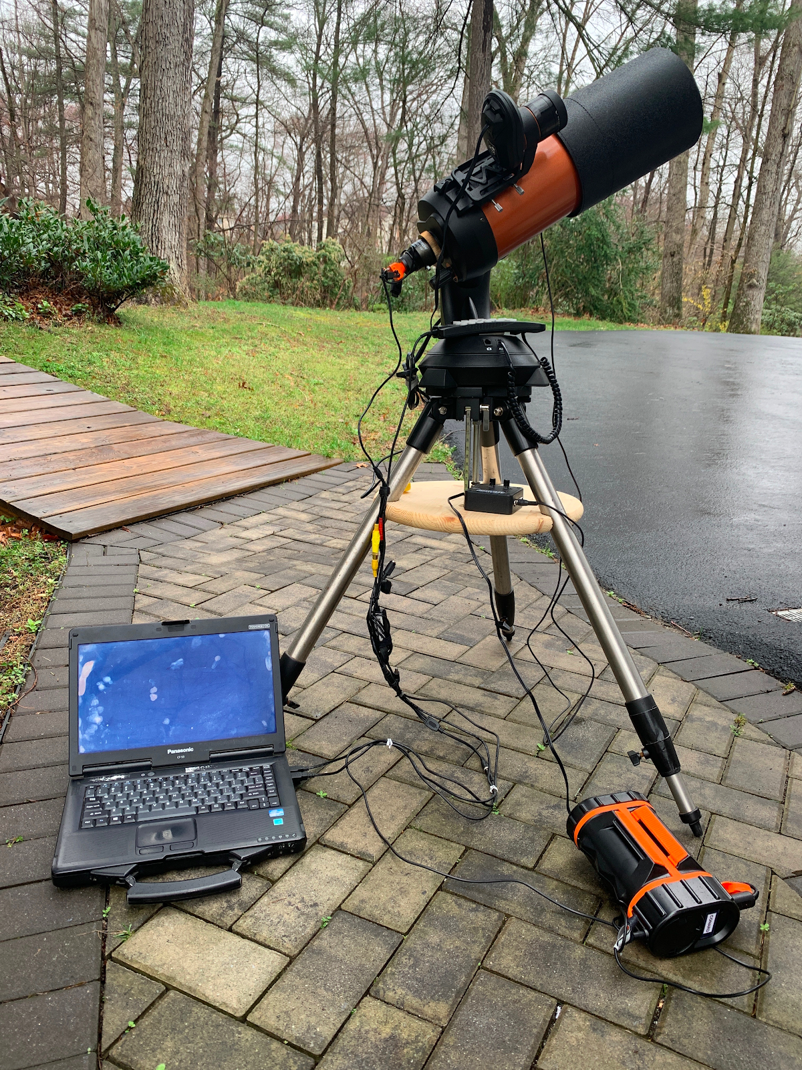
Hardware Components
The telescope used for the prototype of the automated system was a Celestron NexStar 5 SE, a computerized telescope with a 125 mm aperture.
The telescope was equipped with a Celestron StarSense AutoAlign attachment, allowing for self-alignment
The camera used was a RunCam Night Eagle 2 Pro.
The telescope and the camera were connected to a Panasonic Toughbook computer through USB cables.
A Celestron PowerTank Lithium Pro battery was used to power the telescope and the camera.
An heated Astrozap dew shield for five-inch Celestron telescopes was used to protect the telescope lens from condensation
Fig. 1. Photograph of the telescope system and its hardware components

Slide 5
Software Components
The telescope was controlled through CPWI, a software that allows all functions performed on the telescope’s hand controller to be performed on the computer.
This connection allows it to perform both the alignment sequence and the initial slewing to the target star.
IOTA’s video capture software was used to record twice: first, as input for the plate solve software and second, at the time of the event
The plate solve was run on AstroTortilla, a software driven by the Astrometry.net plate solver engine.
ImageJ, an image processing software, was used to convert the first recording by the video capture software from its .avi format to a .fits, which is accessible to the plate solving software.
Fig. 2. The steps of the observation procedure which will be automated, and the software used in each step

Slide 6
Methods of Automation
The software listed on the previous slide were chosen to ensure that all functions that would need to be performed during an observation could be done on a computer, where they could be automated using the scripting language Autoit.
Autoit is designed to interact with and automate Windows GUIs by imitating user input for features like buttons, text fields, and drop-down menus through commands that refer to the unique name of each GUI component.
The program was used for automating the alignment and positioning of the telescope through CPWI and for running the plate solve in AstroTortilla
Some of the programs could not be accessed through Autoit’s functions because the user interface did not adhere to the standards for Windows GUIs. These were automated separately.
ImageJ has its own built-in scripting language which could perform all the necessary functions
The IOTA Video Capture software allowed recordings to be scheduled in advance and required no further automation

Slide 7
Automation Scripting
The code is divided into two scripts: one that runs the alignment and initial positioning of the telescope and another that runs the plate solve and alignment correction.
The two scripts can be scheduled to begin running using Windows Task Scheduler.

Slide 8
Testing and Conclusions
The system was tested with input corresponding to a bright, well known star at a given time. The system worked as intended, proving that it is able to record a specific star at a specific time.
These capabilities are all that is needed to record an actual occultation, so it can be assumed that the system would have worked the same way if the recording had been done on an occulted star during an event.
The success of this system proves that automating the process itself of observing an occultation is possible, and so the idea that a portable, automated device for observing these events can be created is not unreasonable.

